Slide 1


UNIVERSITY OF PRETORIA
ERP 420
Practical 1:
Queuing Theory Investigation and Simulation
Jaco Marais
Adapted By: Llewellyn Strydom
1

Slide 2
Practical Objectives
Improve the understanding of queuing theory.
Understand how to design and analyse queuing models.
Compare queuing models and report on findings.
Simulate a model and verify results.
1

Slide 3
Practical Questions
2 Practical Questions:
Analysis and comparison of queuing models
M/M/1 queuing simulator
ECSA ELO 4:
Documentation ability
ECSA ELO 5:
Engineering methods, skills, tools and information technology
1

Slide 4
Demo simulator 16 August 2019
Report is due 30 August 2019
Analysis and comparison of queuing models
Design of simulator etc.
1

Slide 5
Analysis and Comparison of Queuing Models
Description
3 Primary Characteristics:
Arrival process
Service process
Number of servers
Kendall’s Notation:
A/S/n
A – arrival process
S – service process
N – number of servers
1

Slide 6
Analysis and Comparison of Queuing Models
Description
A and S can be classified as either:
M (Markov) – exponential distribution
D (Deterministic) – constant value
G (General) – any arbitrary probability distribution
Queuing models to be investigated:
M/M/1
M/M/s
M/M/∞
1

Slide 7
Analysis and Comparison of Queuing Models
What to Deliver
Students should find resources to help them understand queuing theory.
Everyone must use λ = 50 packets/min (average arrival rate) and µ = 65 packets/min (average service rate).
Parameters λ and µ will be used to calculate the other model parameters.
Model parameters can be calculated analytically.
1

Slide 8
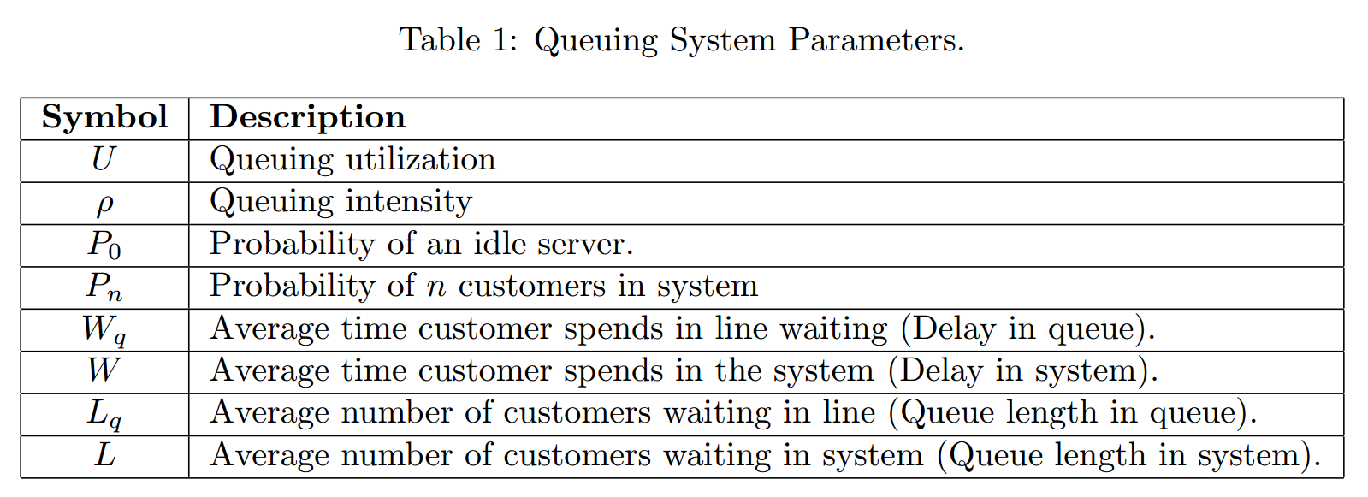
Analysis and Comparison of Queuing Models
What to Deliver
1

Slide 9
Analysis and Comparison of Queuing Models
What to Deliver
Calculate the model parameters for each model.
Compare the different models.
Investigate and report on the influences when changing specific parameters (e.g. no. of servers).
Focus on justification and optimization.
Give scenarios where models would perform best/worst.
1

Slide 10
Analysis and Comparison of Queuing Models
What to Deliver
Graphs:
Response time vs Utilization (single and multi-server comparison)
Number of customers vs Throughput
Number of customers vs Response Time
Number of customers vs Utilization
Note: Generate graphs for each model, these must be on the same plot.
1

Slide 11
M/M/1 Queuing Simulator
Description
Simulate a lossless M/M/1 queuing system
Read data from a given trace file and calculate the average arrival time (λ), average service time (µ) and the average queuing delay.
Modify the simulator to generate a custom trace file from specific input parameters.
Link capacity (100 Mbps)
Average packet size (1000 bits)
1

Slide 12
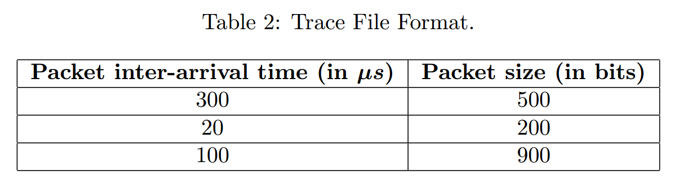
M/M/1 Queuing Simulator
Trace File
Note: Assume that time starts a zero.
1

Slide 13
M/M/1 Queuing Simulator
What to Deliver
Read data from a given trace file and calculate the average arrival time (λ), average service time (µ) and the average queuing delay.
Generate a trace file with 100 seconds of traffic with 100 different variations (for meaningful average queuing delay).
Compare different workloads and discuss how this affects λ and µ.
Plot queue length vs. time graph (at different workloads).
1

Slide 14
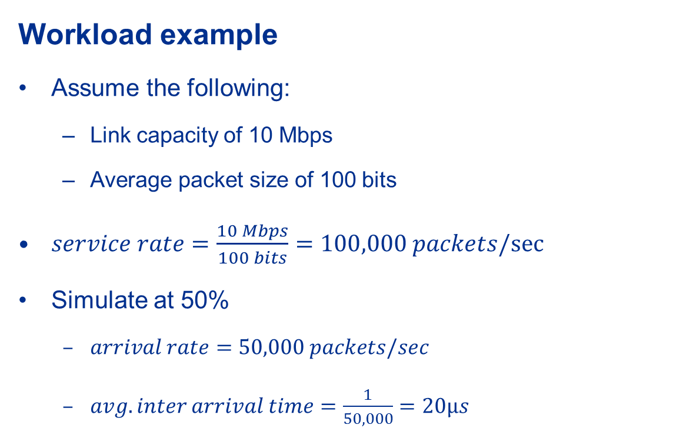
M/M/1 Queuing Simulator
Example values!
Use guide
1

Slide 15
M/M/1 Queuing Simulator
Workload example
In each of the 100 runs:
Inter-arrival dataset:
Generate 50,000 x 100 numbers (100 sec of traffic)
Use exponential distribution with a mean of 20 µs
Packet size dataset:
Generate 50,000 x 100 numbers (100 sec of traffic)
Use exponential distribution with a mean of 100 bits
Note: Use a different seed to generate the numbers in each run.
1
Notes:
<number>

Slide 16
Demonstration
Demonstration
10 minute slot
Explain code and implementation
Make use of lab book and report
1

Slide 17
Report
Format
Follow EPR400 report standards (figure and table captions)
Follow the standard, not the template!
Hard copy of report due 30 August 2019
Content
Follow guide
1

Slide 18
Additional Information
Submit soft copy of report and source code
Submission completed on ClickUP as an assignment
Remember your report mark is your ELO 4 mark
The EPS will be used for marking
1

Slide 19



Questions?
1

